Slide 1
Climate Change Awareness Assembly

Slide 2
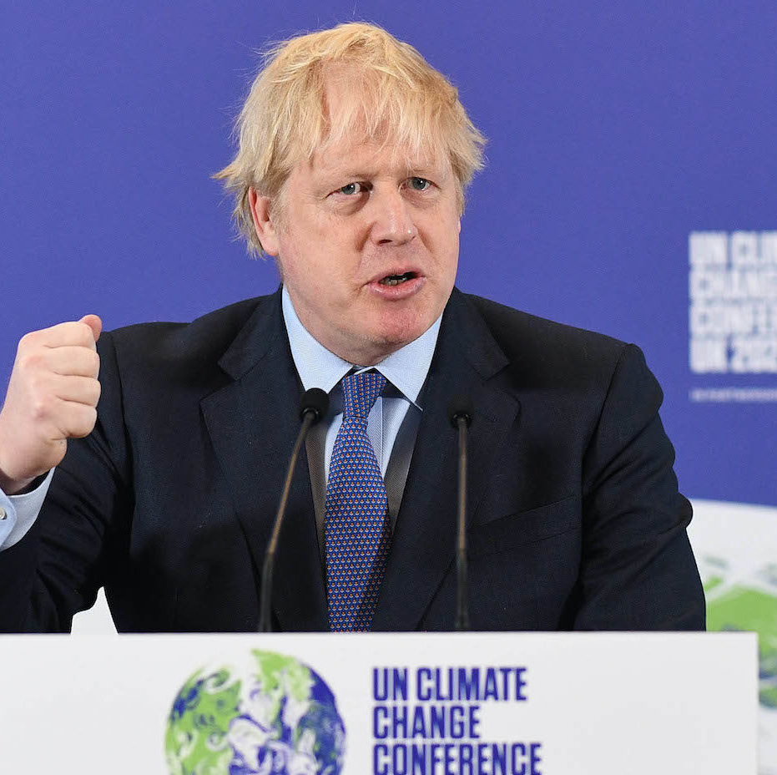
What is COP26? What does COP26 stand for?
COP stands for Conference of the Parties, and will be attended by countries that signed the United Nations Framework Convention on Climate Change (UNFCCC) . A treaty agreed in 1994.
It is an important meeting where all the leaders from around the world will meet to discuss climate change and plan how to tackle it.
COP26 is taking place in Glasgow in Scotland.

Slide 3
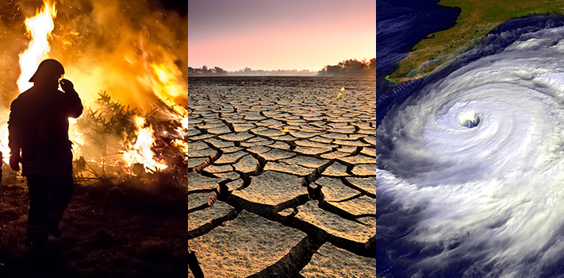
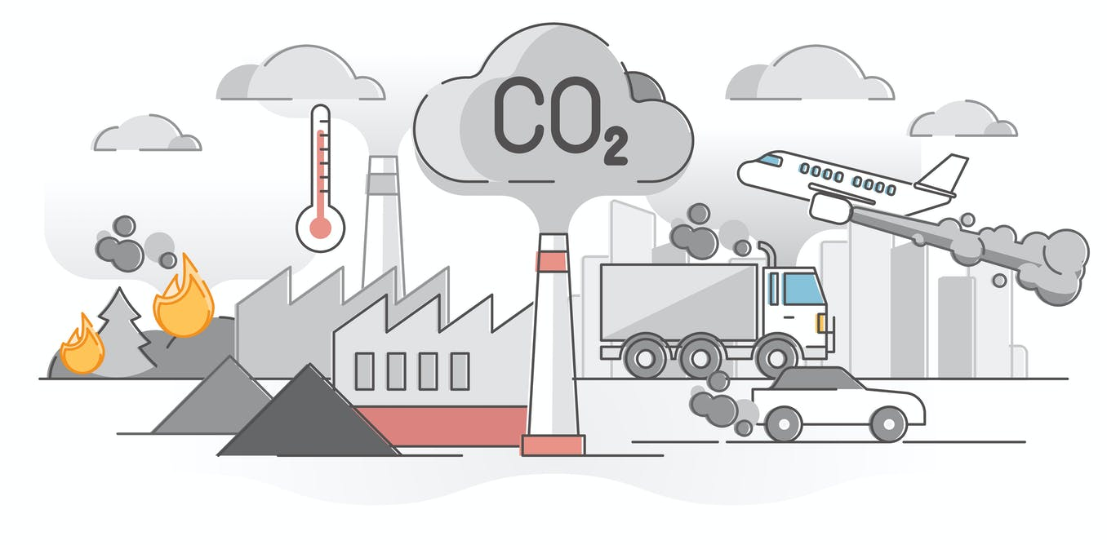
Why are leaders meeting in Scotland to discuss climate change?
The world is getting warmer because of fossil fuel emissions caused by humans.
Carbon dioxide is released naturally but humans have increased this by burning fossil fuels like coal and oil.
This causes climate change and also extreme weather conditions such as flooding, droughts and forest fires.
The past decade was the warmest on record!
This is why leaders are meeting to make agreements on the urgent action that is needed to reduce carbon emission.

Slide 4
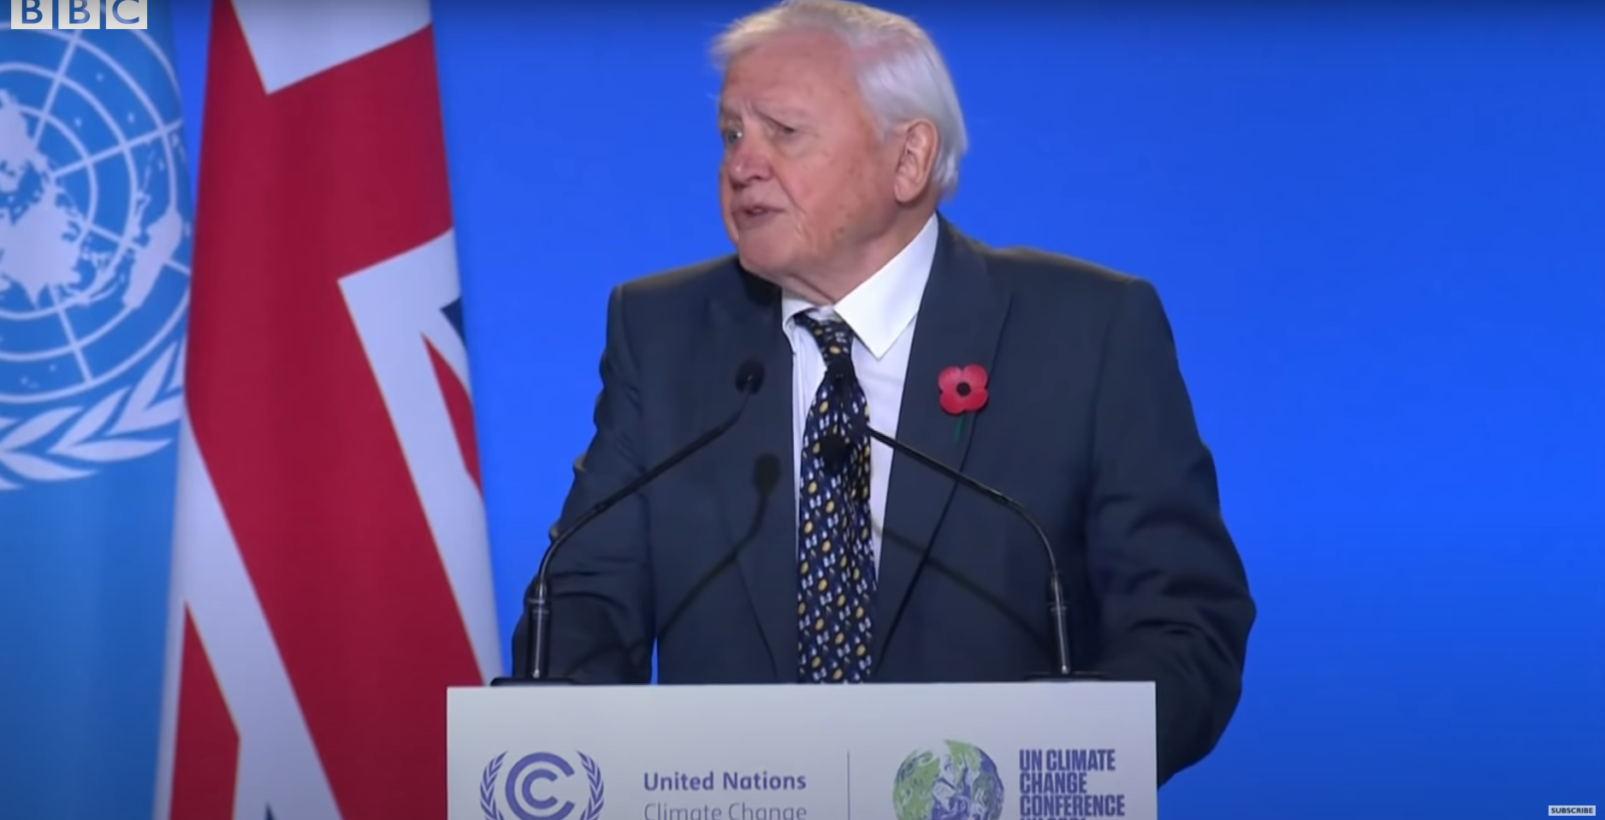
David Attenborough urges leaders to make a change
https://www.youtube.com/watch?v=iKoqQTRERnA

Slide 5
What can we do to reduce our own CO2 emissions?
Turn
Turn lights and computers off when they are not being used.
Recycle
Recycle paper and plastic.
Support
Support our Hackney Schools Street by walking, cycling or scootering to school.

Slide 6
What can you do at home?
You can recycle at home to reduce the amount of waste that goes in our landfill.
You can use public transport to travel.
Turn any switches off when you are not using it. If you are in a room and it is not being used, turn off the light!
You can help by planting, as your new plants and trees will help to remove the greenhouse gas CO₂ from the air.
Speak to your parents or adults about ways to reduce emissions and help our planet.

Slide 7
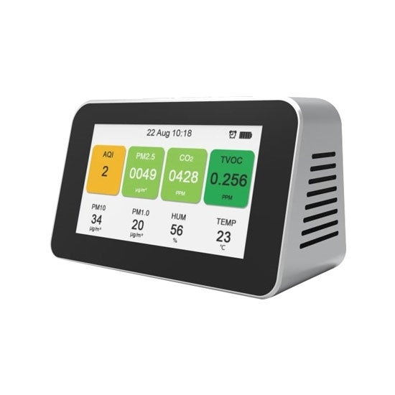
Measuring our CO2 levels at school
As a school, we will be measuring our CO2 levels using air quality monitors.
There will be one placed in different parts of the school.
This will help us to plan ways to improve our CO2 levels.

